Slide 1

Presented by : K D Manoj Kumar
Cracking the Code:
CodeX's Strategy to Conquer the Indian Energy Drink Market
Resume Project challenge #6

Slide 2






Agenda
Overview of the company
Objective of the presentation
Market overview
Primary Insights
Additional market research
Recommendations for CodeX

Slide 3
Company overview:
CodeX, a fictional German-based beverage company wants to establish itself in the Indian market. They launched their energy drink a few months ago in 10 Indian cities.
They conducted a survey in those 10 cities and
received results from 10k respondents.
The primary objective of company now
is to enhance brand awareness, expand
market share, and drive product
development by leveraging survey data.

Slide 4
Objective of the presentation
Peter Pandey, a marketing data analyst is tasked Convert survey results into actionable insights. which the team can use to drive actions.
Utilize insights to fuel strategic decision-making.
Establish CodeX as a prominent player in the Indian market.

Slide 5
Market Overview
As of 2021, the market size for energy drinks amounted to INR 2,400 crore in India, indicating the total value of the market in terms of revenue.
The energy drinks market is experiencing a compound annual growth rate (CAGR) of 45-50% in India, indicating a rapid expansion in its size and popularity.
The energy drinks market is propelled by factors such as growing awareness of their benefits, evolving lifestyles, rising disposable income, and increasing brand awareness.

Slide 6
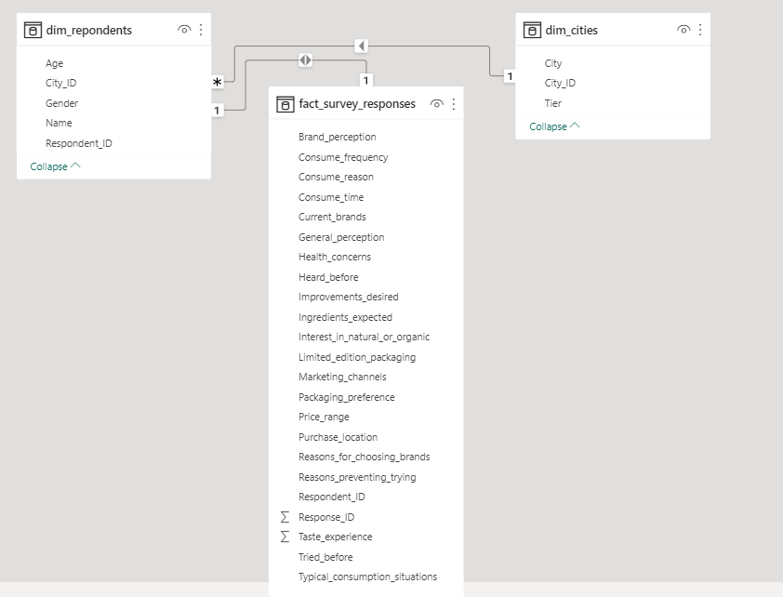
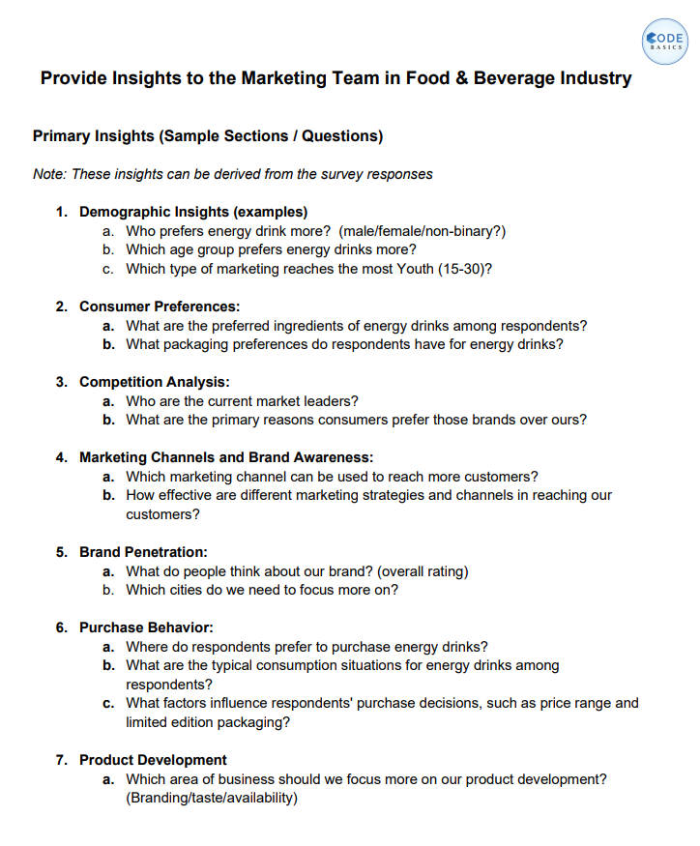
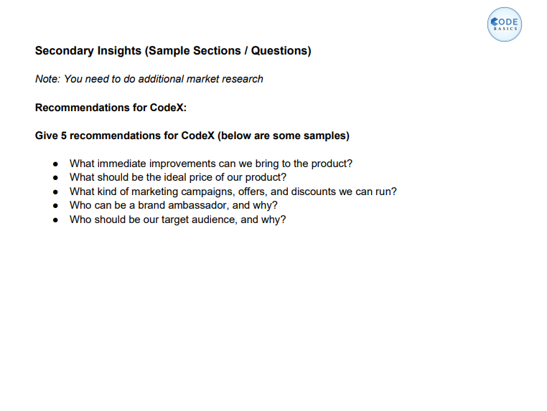


Data requests & tools

Slide 7
Primary Insights
Demographic Insights
Consumer Preferences
Competition Analysis
Marketing Channels and Brand Awareness
Brand Penetration
Purchase Behaviour
Product Development

Slide 8
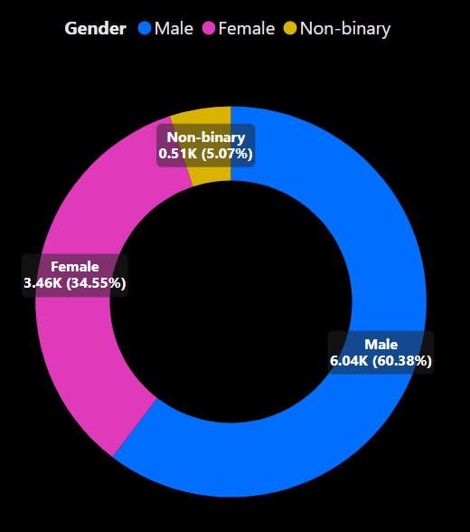
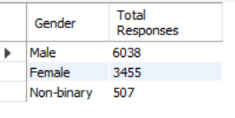

Demographic Insights
Who prefers energy drink more?(male/female/non-binary?)
Insights: Males dominate energy drink preference among 10,000 respondents, with 60.38% choosing it. Followed by Females with 34.55%.

Slide 9
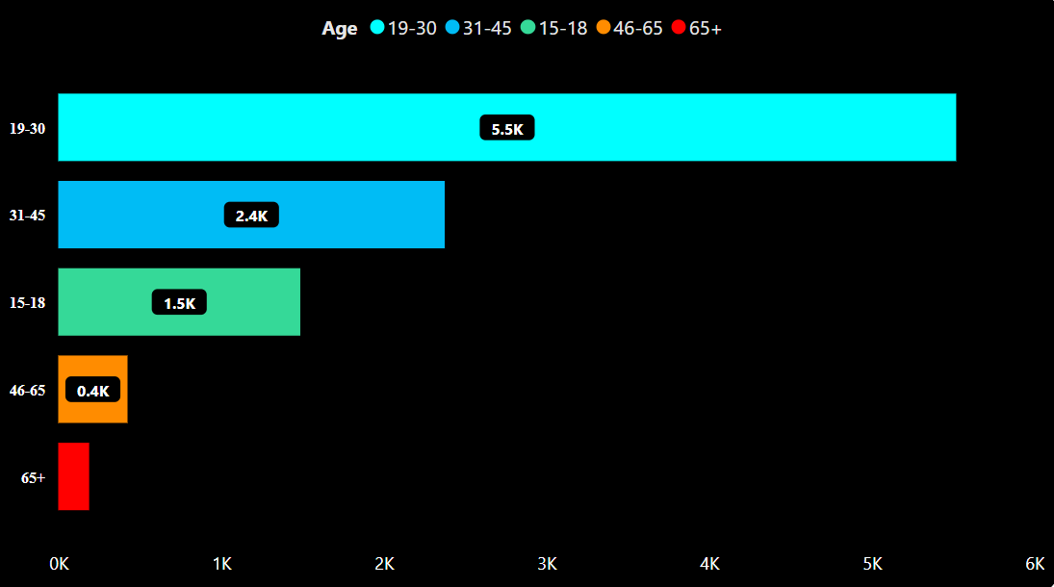
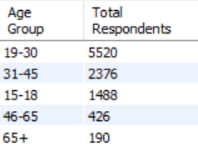

Demographic Insights
Which age group prefers energy drinks more?
Insights: The 19-30 age group exhibits the highest preference for energy drinks.

Slide 10
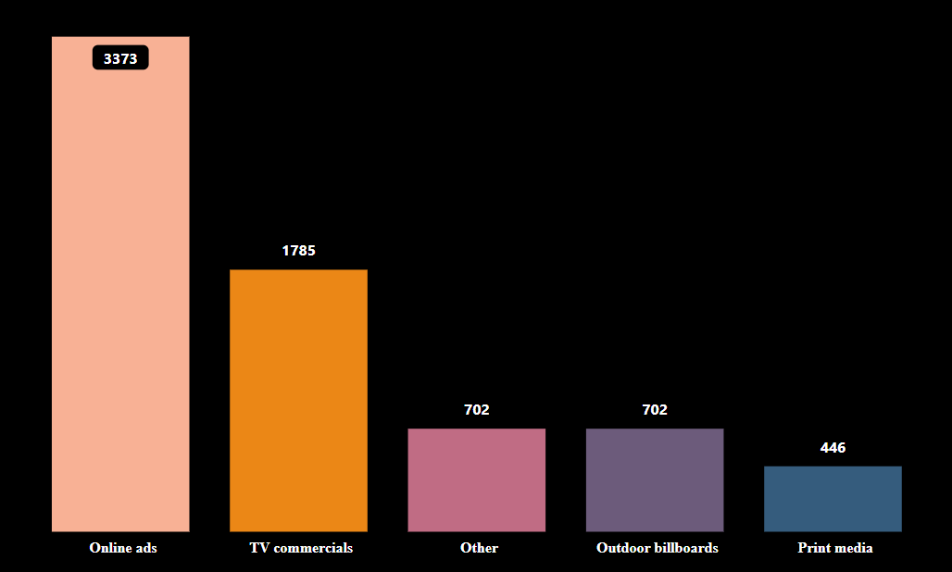
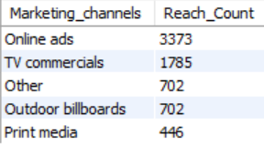
Demographic Insights
Which type of marketing reaches the most Youth (15-30) ?
Filtered the visual as well as analysis tools with age-group between 15 – 30,
Insights: Online ads and TV commercials are the most effective marketing channels for reaching the youth (15-30) segment.

Slide 11
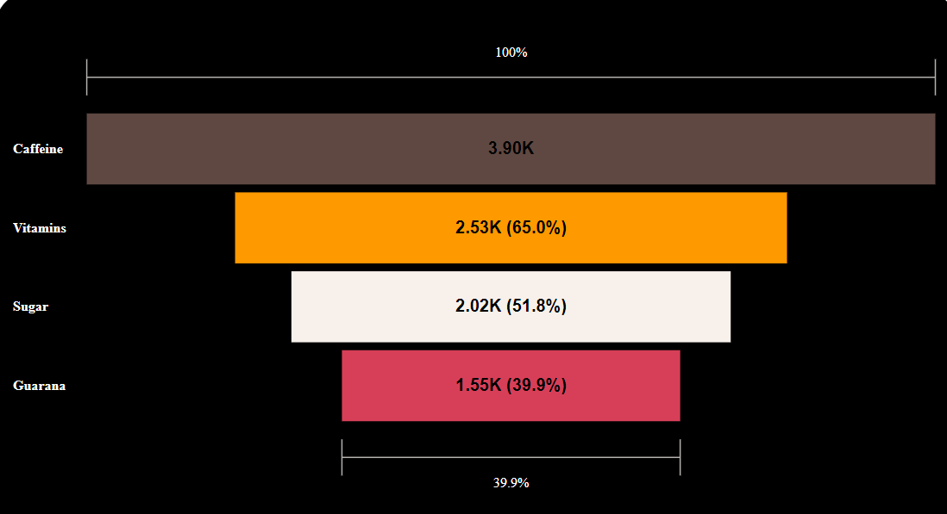
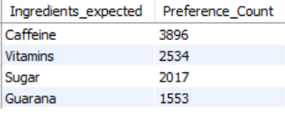
Consumer Preferences
What are the preferred ingredients of energy drinks among respondents?
Insights : Caffeine, and vitamins are the top preferred ingredients among energy drink consumers.

Slide 12
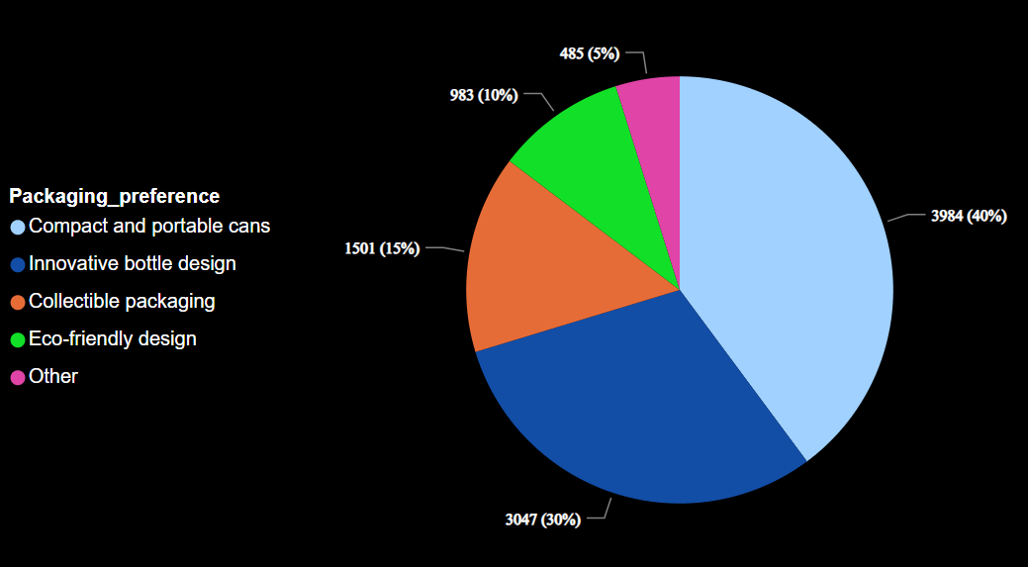
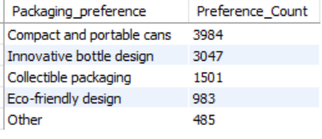
Consumer Preferences
What packaging preferences do respondents have for energy drinks?
Insights : Respondents show a preference for compact and portable cans as their preferred packaging choice for energy drinks.

Slide 13
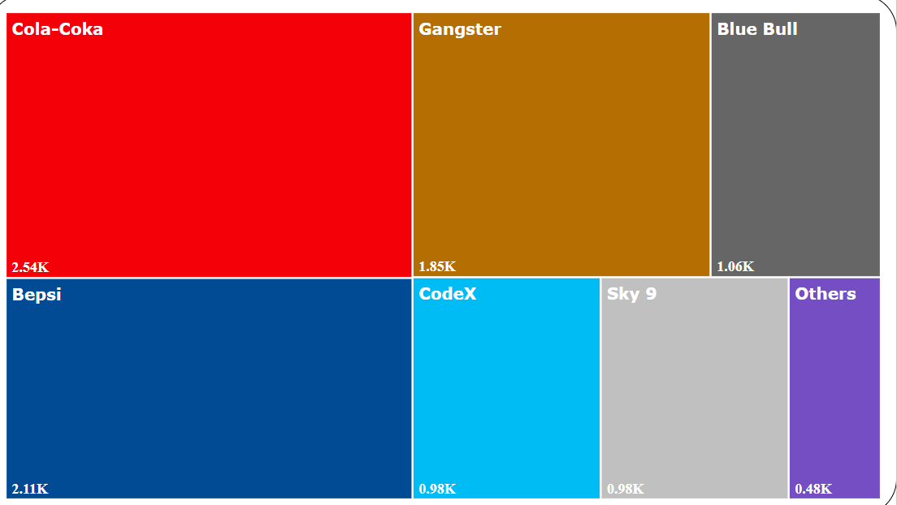
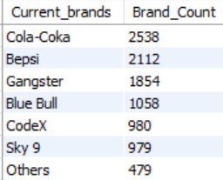
Competition Analysis
Who are the current market leaders?
Insights : Cola Coka, Bepsi, and Gangster are the top market leaders in the energy drink industry.

Slide 14
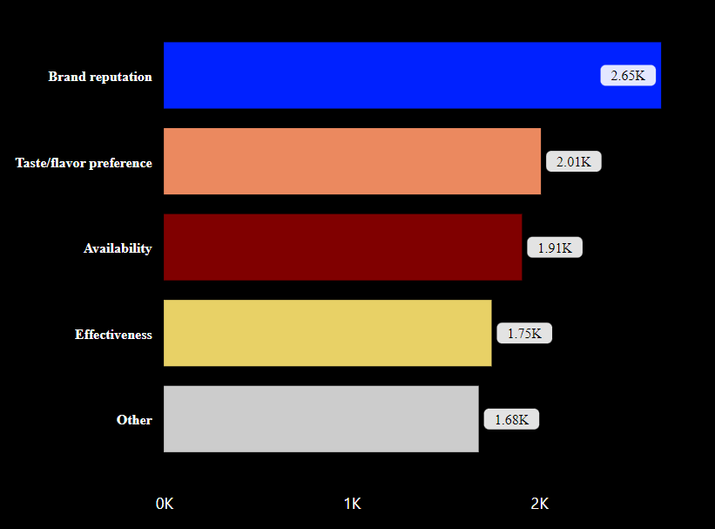
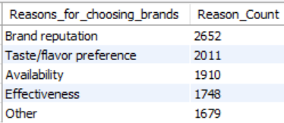
Competition Analysis
What are the primary reasons consumers prefer those brands over ours?
Insights : Brand reputation plays a key role so we need to put an extra effort in order to establish reputation in the Indian market.

Slide 15
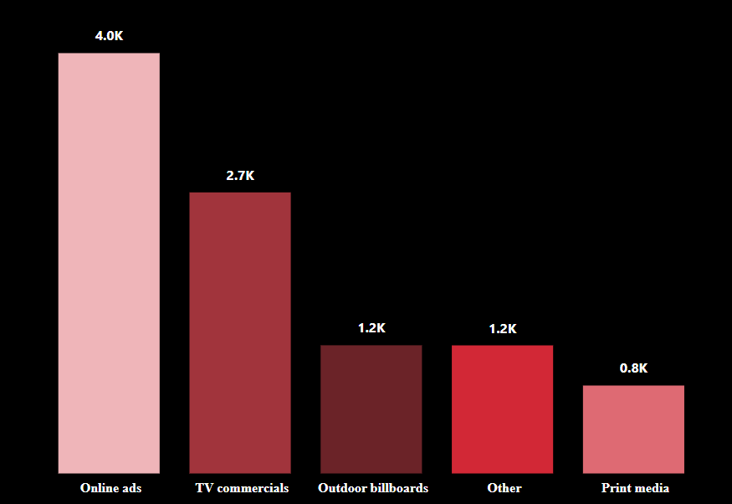
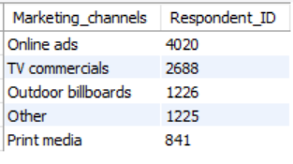
Effective Marketing Channels and Brand Awareness"
Which marketing channel can be used to reach more customers?
Insights : Online ads (40.2%) have the highest reach among the customers followed by TV commercials (26.88%) ,an effective channel for reaching wide audience.

Slide 16
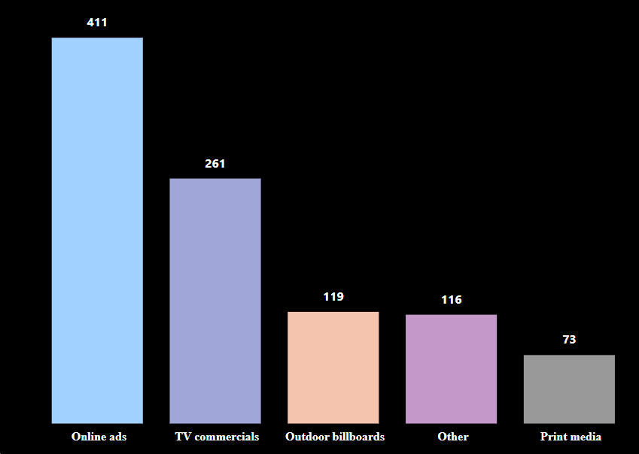
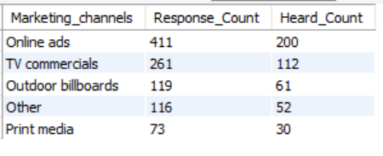
Effective Marketing Channels and Brand Awareness"
How effective are different marketing strategies and channels in reaching our customers?
Insights : As we can see, 200 people found out about our product through online advertisements, and 112 customers did so through TV advertising. As a result, these two channels need to be given priority, and we also need to pay close attention to other marketing channels.

Slide 17
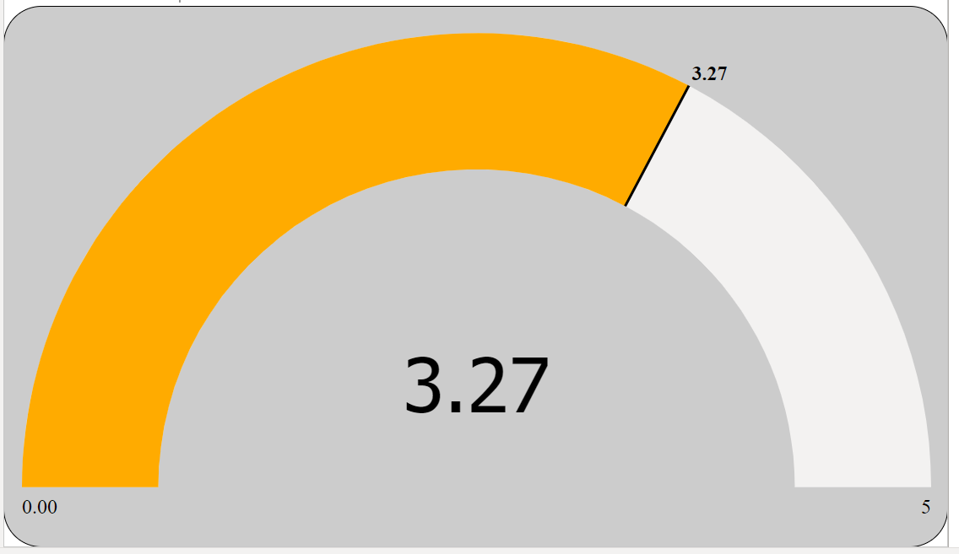
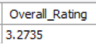
Brand Penetration
What do people think about our brand? (overall rating)
Insights : Our brand receives an overall rating of 3.27, indicating average customer perception and satisfaction.

Slide 18
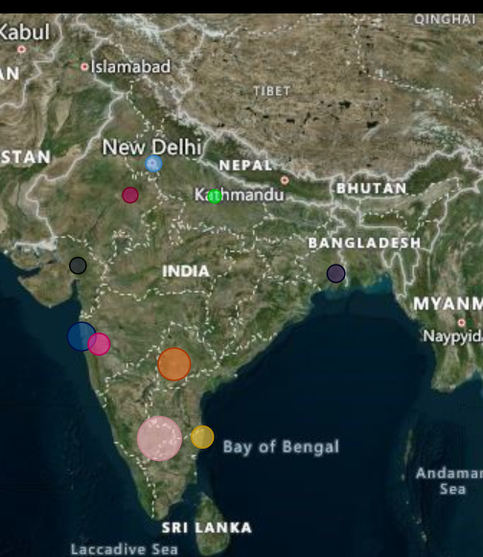
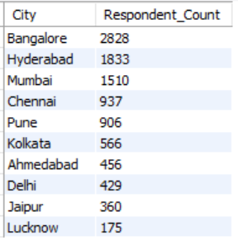
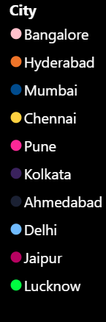
Brand Penetration
Which cities do we need to focus more on?
Insights : Lucknow, Jaipur, and Delhi should be our main areas of concentration in order to spread knowledge of our energy drink there.

Slide 19
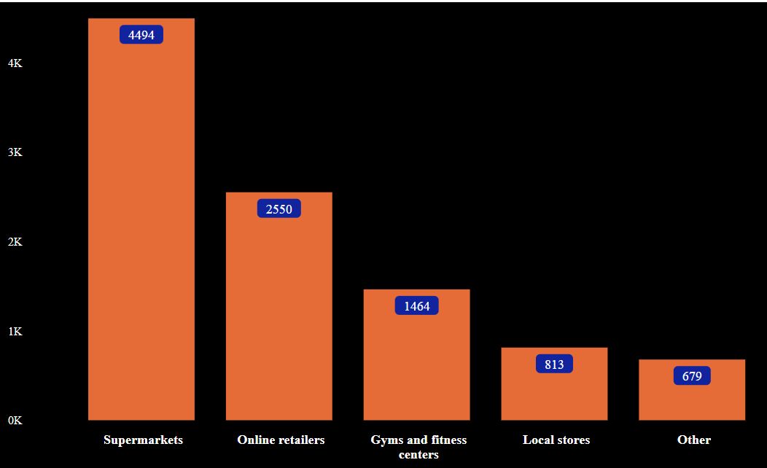
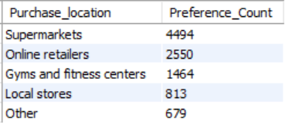
Purchase Behaviour
Where do respondents prefer to purchase energy drinks?
Insights : many customers choose supermarkets, online retailers & Gyms as top 3 purchasing spots.

Slide 20
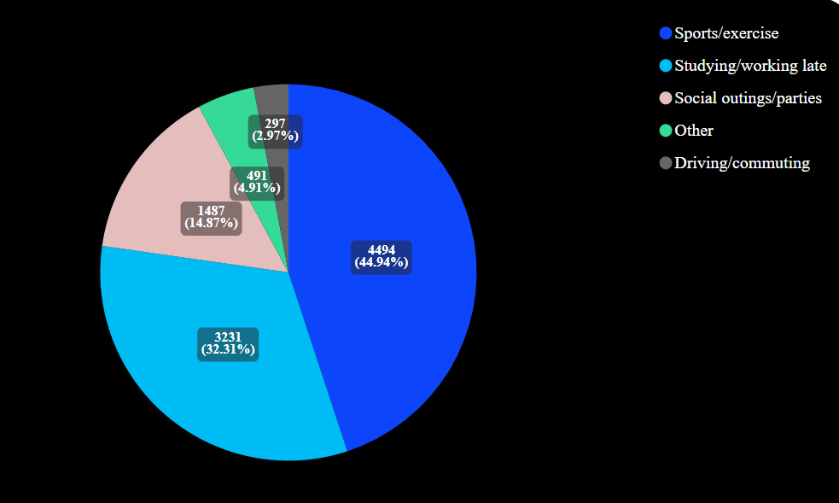
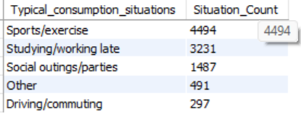
Purchase Behaviour
What are the typical consumption situations for energy drinks among respondents?
Insights : As expected sports/exercise tops the list followed by studying/working late .

Slide 21
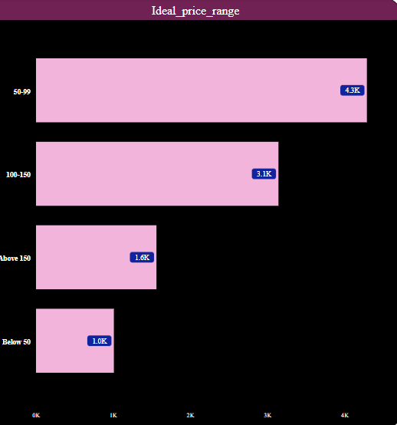
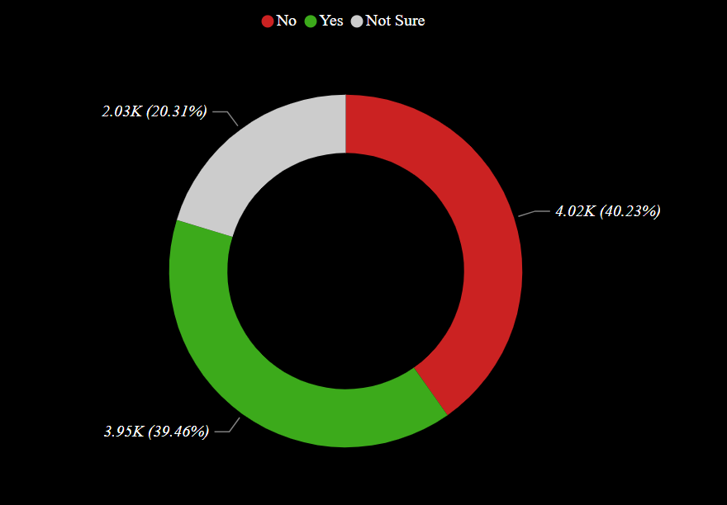
Purchase behaviour
What factors influence respondents' purchase decisions, such as price range and limited edition packaging?
Limited edition packaging
Insights : Pricing Strategy: a significant number of respondents prefer the price range of 50-99.

Slide 22
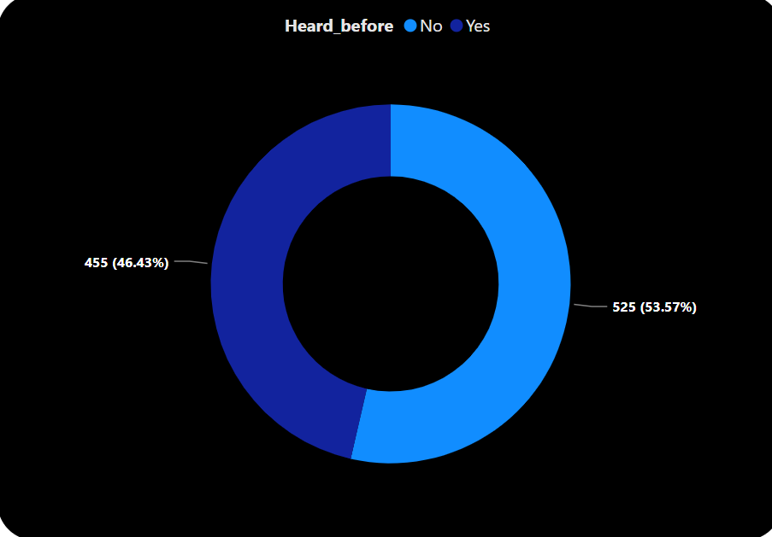
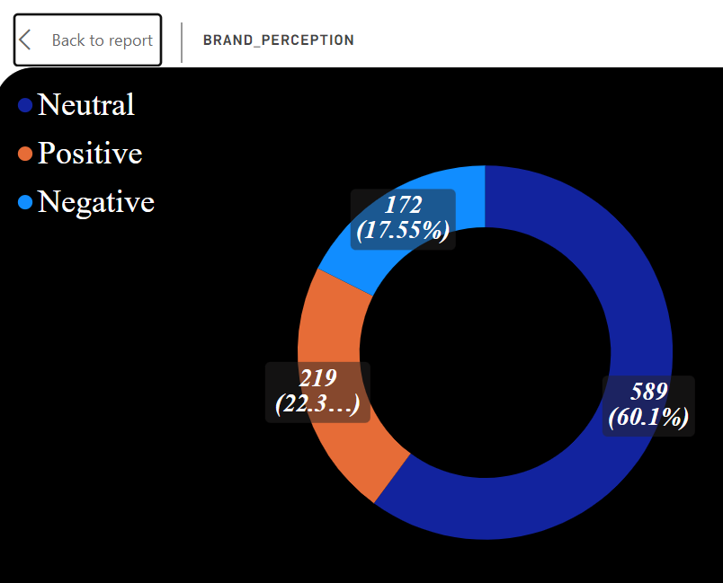
Product Development
Which area of business should we focus more on our product development? (Branding/taste/availability) Overall Rating we need separate survey for branding
Insights : we need an awareness program so that large number of customers know about the codex energy drink brand To improve brand perception, we recommend strengthening brand messaging, implementing targeted marketing campaigns, and enhancing the product's visual identity.

Slide 23
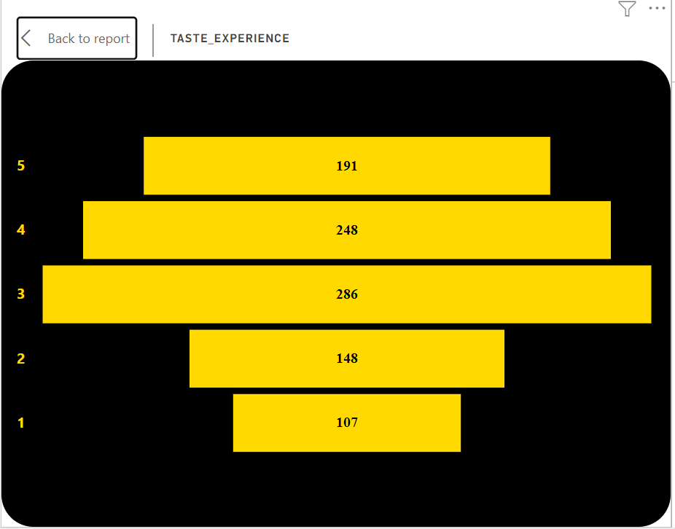
Product Development
Insights : These ratings indicate that there is room for improvement in terms of taste and flavor. Enhancing the formulation, considering flavor preferences, and conducting taste tests with the target audience can help refine the taste profile and enhance consumer satisfaction.

Slide 24
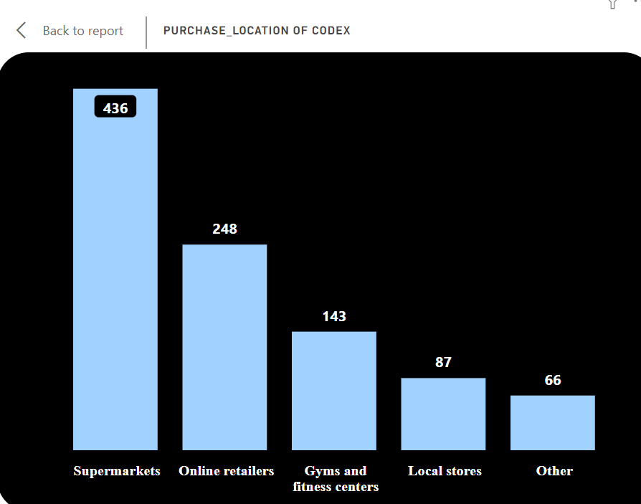
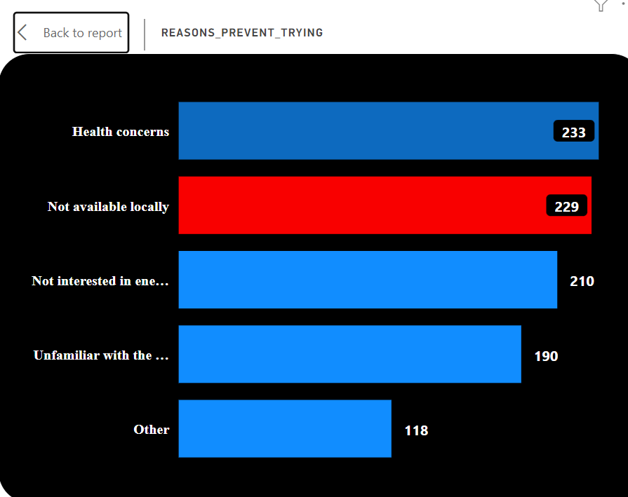
Product Development
Insights : We need to Address the concern of limited availability by expanding distribution channels, strengthening partnerships with retailers, and increasing the presence of CodeX's energy drink in different locations.

Slide 25
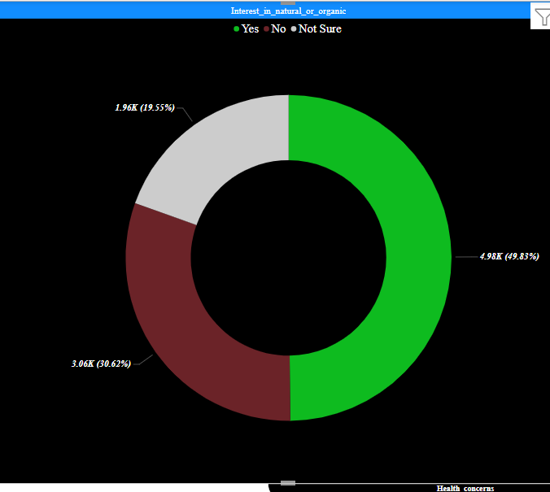
Additional market research
Insights: CodeX can consider developing a variant of their energy drink that emphasizes natural or organic ingredients, catering to the preferences of this segment of their consumer base.

Slide 26
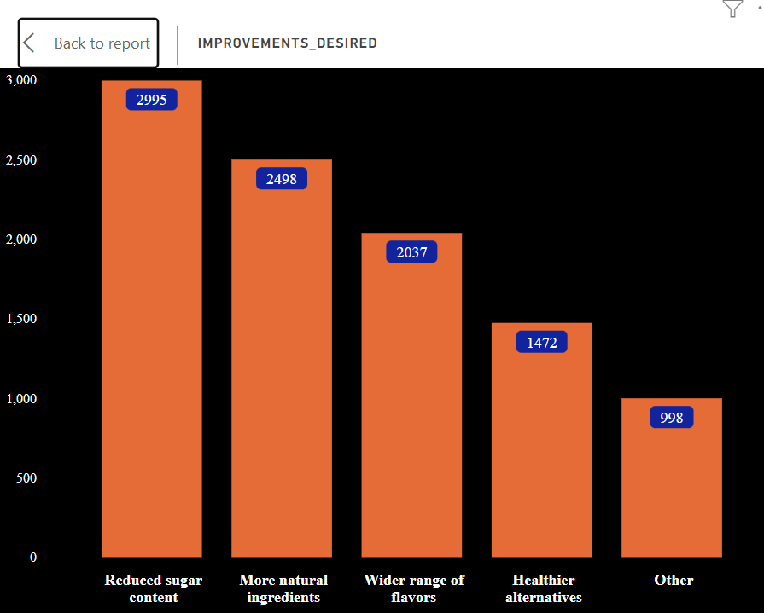
Additional market research
Insights: CodeX can meet consumer demand by offering energy drinks with reduced sugar content or sugar-free options. Highlighting these features can attract health-conscious consumers. Additionally, incorporating more natural ingredients will further differentiate CodeX's product in the market.

Slide 27
Recommendations for CodeX
What immediate improvements can we bring to the product?
Insights: To improve the product, - Focus on enhancing the taste by refining the formulation and incorporating feedback.
- Address consumer demand for reduced sugar by offering sugar-free options.
- Expand flavor options to attract a wider customer base.
- Enhance packaging design to stand out and reflect the brand image.
- Clearly communicate health benefits on packaging and marketing materials.
- Incorporate natural and organic ingredients to cater to health-conscious consumers.
- Additionally, introduce smaller cans to encourage trial and appeal to consumer preferences. These improvements will elevate CodeX's energy drink and meet consumer expectations.

Slide 28
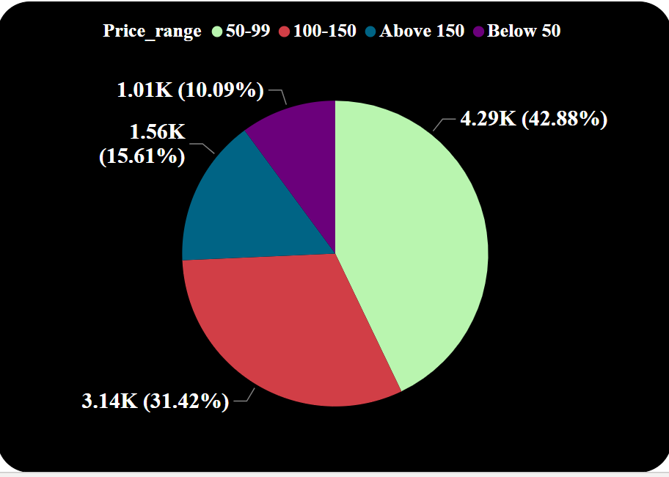
Recommendations for CodeX
What should be the ideal price of our product?
Insights: Based on the survey data, the ideal price range for CodeX's energy drink should be between 50 and 99, as preferred by the majority of respondents.

Slide 29
Recommendations for CodeX
What kind of marketing campaigns, offers, and discounts we can run?
Insights: - Collaborations with fitness brands, fitness centers & fitness influencers create synergies and expand reach. - Targeted online ad campaigns on platforms like YouTube, Instagram, Facebook
etc generate brand awareness.
- Time-limited promotions create urgency.
- Bundle deals offer discounted multi-packs. Sampling programs at gyms and events generate trial and awareness.

Slide 30
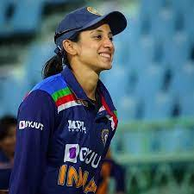
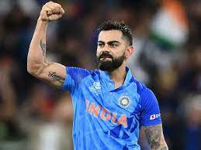
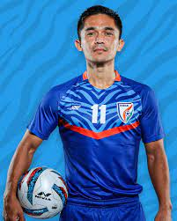
Recommendations for CodeX
Who can be a brand ambassador, and why?
Insights: Smriti Mandhana: Inspires female consumers with her strong performance in women's cricket.
Virat Kohli: Dynamic cricketer known for leadership and fitness dedication.
Sunil Chhetri: Inspiring captain of the Indian football team with skill and leadership qualities.

Slide 31
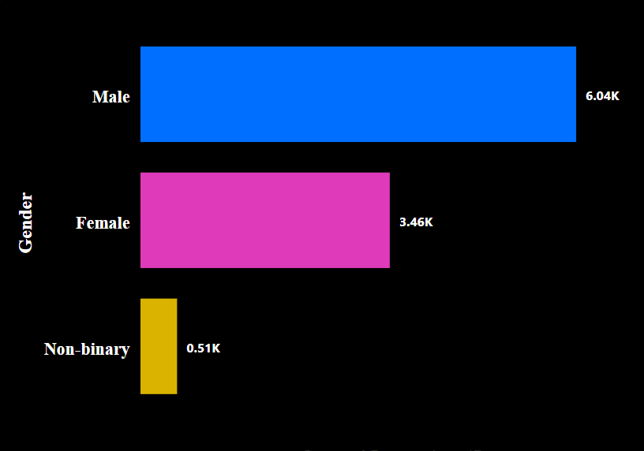
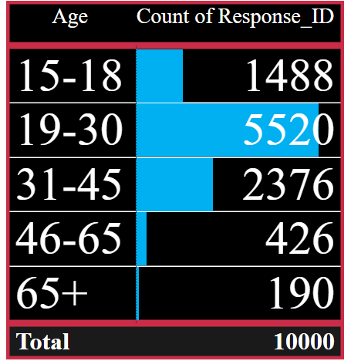
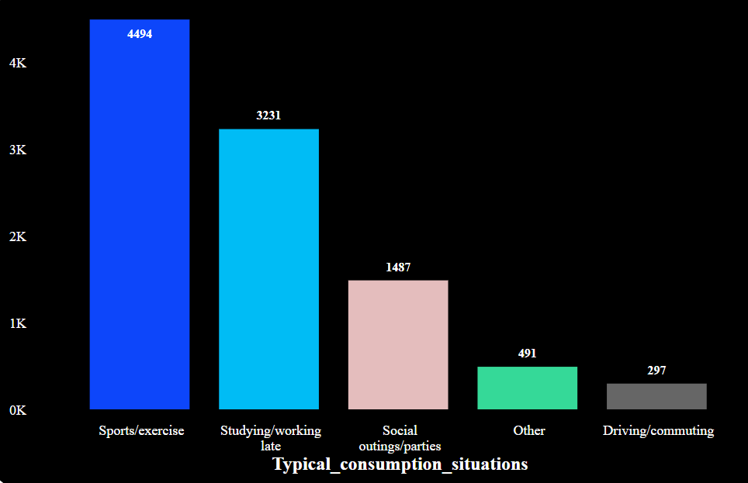
Recommendations for CodeX
Who should be our target customers ?
Insights:CodeX should target health-conscious males (19-30) engaged in sports, exercise, and late work/study.

Slide 32



Thank you Codebasics team

